Slide 1
CRISP-DM case study Rocket league rank predictor
Pasquale De Marinis

Slide 2

Business Understanding
Rocket League
Multiplayer Online Game
Hybrid soccer-car game
Soccer game, but with cars instead of humans
Competitive
Ranking system

Slide 3

Rocket League Competitive Ranks
22 Ranks
Player is classified into a rank after playing 10 matches in competitive
Ranks are a discretization of an «invisible» number called Match Making Rating (MMR)

Slide 4
Rocket League Competitive Ranks
At the first match
MMR = 600
He wins: MMR += G
He loses: MMR -= G
G is 150 at the first match
Decreases after each match until 10 after a dozen of matches

Slide 5
Rocket League Competitive Ranks
Player converges into their appropriate rank
Plays with same skill level players
Relatively slow convergence (20-30 matches)
G is only determined by match outcome and not by player skills shown in the match

Slide 6
Business Understanding Determine Business Objectives
Business problem: slow rank convergence, unfair ranking; need for a more fast and fair ranking system
Business opportunity: create a system capable of determining the player rank analyzing the performances shown during the match

Slide 7
Business Understanding Determine Business Objectives
Business objectives
Predict the rank of a player from the skill shown during the match
Business Success Criteria:
Positive feedback by the community after its implementation
Increase in daily active players by 5%

Slide 8
Business Understanding Determine Data Mining Goals
High level goal: prediction
Task: regression
dependent variable is the MMR
Success criteria:
Mean Absolut Error < 2.0
Root Mean Squared Error < 2.5
Inference time < 0.5 seconds on CPU AMD Ryzen 2600x

Slide 9
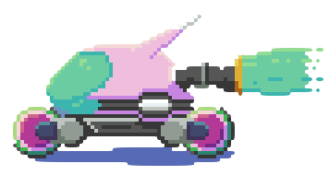
Data Understanding Collect Initial Data
ballchasing.com
Collects replays from players and provide statistics about
Replay: large binary file containing information about each instant in the game (each player, ball position, direction, speed etc.)
Ballchasing API used to collect replay statistics:
JSON file

Slide 10
Data Understanding Collect Initial Data
Collection process:
For each iteration:
For each rank i:
Sampled a date-hour range in the last year
Get all replays in that range
Until new_replay_ratio is low or N_i replays are retrieved
Until N replays are retrieved
A sort of stratified cluster sampling

Slide 11
Data Understanding Collect Initial Data
From each replay 6 rows are extracted
Each match has 6 players
Problems:
«Low» ranks are underrepresented
Less replayes founds
Unbalanced data
To upload replays, user needs the ballchasing plugin
Low ranks players tendentially doesn’t now or are not interested

Slide 12
Data Understanding Describe Data
404951 rows
84 columns
1 categorical nominal feature
MVP
24 numeric discrete features
saves | goals_against_while_last_defender | count_powerslide | amount_overfill_stolen
assists | shots | amount_collected_small | amount_collected
goals | inflicted | amount_collected_big | amount_stolen
taken | shots_against | amount_stolen_small | amount_stolen_big
count_collected_big | count_collected_small | amount_overfill | amount_used_while_supersonic
count_stolen_big | count_stolen_small | score | goals_against

Slide 13
Data Understanding Describe Data
59 continuous features
percent_closest_to_ball | time_offensive_half | percent_boost_50_75 | percent_boost_speed
avg_speed_percentage | percent_boost_25_50 | time_high_air | percent_supersonic_speed
bcpm | percent_farthest_from_ball | time_defensive_third | time_neutral_third
avg_distance_to_mates | percent_high_air | avg_amount | percent_most_forward
percent_slow_speed | time_behind_ball | time_slow_speed | avg_distance_to_ball_no_possession
time_supersonic_speed | percent_offensive_half | percent_neutral_third | total_distance
percent_full_boost | time_zero_boost | time_closest_to_ball | time_low_air
percent_ground | shooting_percentage | percent_boost_0_25 | avg_distance_to_ball
time_full_boost | time_boost_50_75 | time_infront_ball | time_boost_25_50
avg_speed | percent_behind_ball | percent_boost_75_100 | time_boost_speed
percent_zero_boost | avg_powerslide_duration | time_boost_0_25 | time_boost_75_100
goals_against | percent_defensive_half | percent_most_back | time_ground
time_most_back | percent_defensive_third | bpm | time_powerslide
time_farthest_from_ball | percent_low_air | avg_distance_to_ball_possession | time_defensive_half
time_offensive_third

Slide 14
Data Understanding Verify data quality
Accurate: data cannot be subject to human errors, due to its generation process.
It is possible to do a consistency check on counts and percentages and times
> 0
< 100 for percentages
All rows passed this checks

Slide 15
Data Understanding Verify data quality
Incomplete: some rows have missing values in the following columns:
percent_closest_to_ball,
percent_farthest_from_ball,
percent_most_forward,
avg_distance_to_mates, time_most_back
tier
Can be due to leaving the match before the end, or connections errors during the match or player is not ranked

Slide 16
Data Understanding Verify data quality
Up-to-date:
Data refers to a single match
Data is calculated from the replay file.
After the replay is built it can’t be updated
Thus, data can’t be outdated

Slide 17
Data Understanding Verify data quality
Consistent - Measures:
Distances : unreal units (= centimeters)
Speeds: uu/s
Measures units are consistent for all the features

Slide 18
Data Preparation Clean Data
Anticipated step, with missing values, data can’t be explorated
199 rows contained missing data
Most simple approach chosen: remove those rows

Slide 19
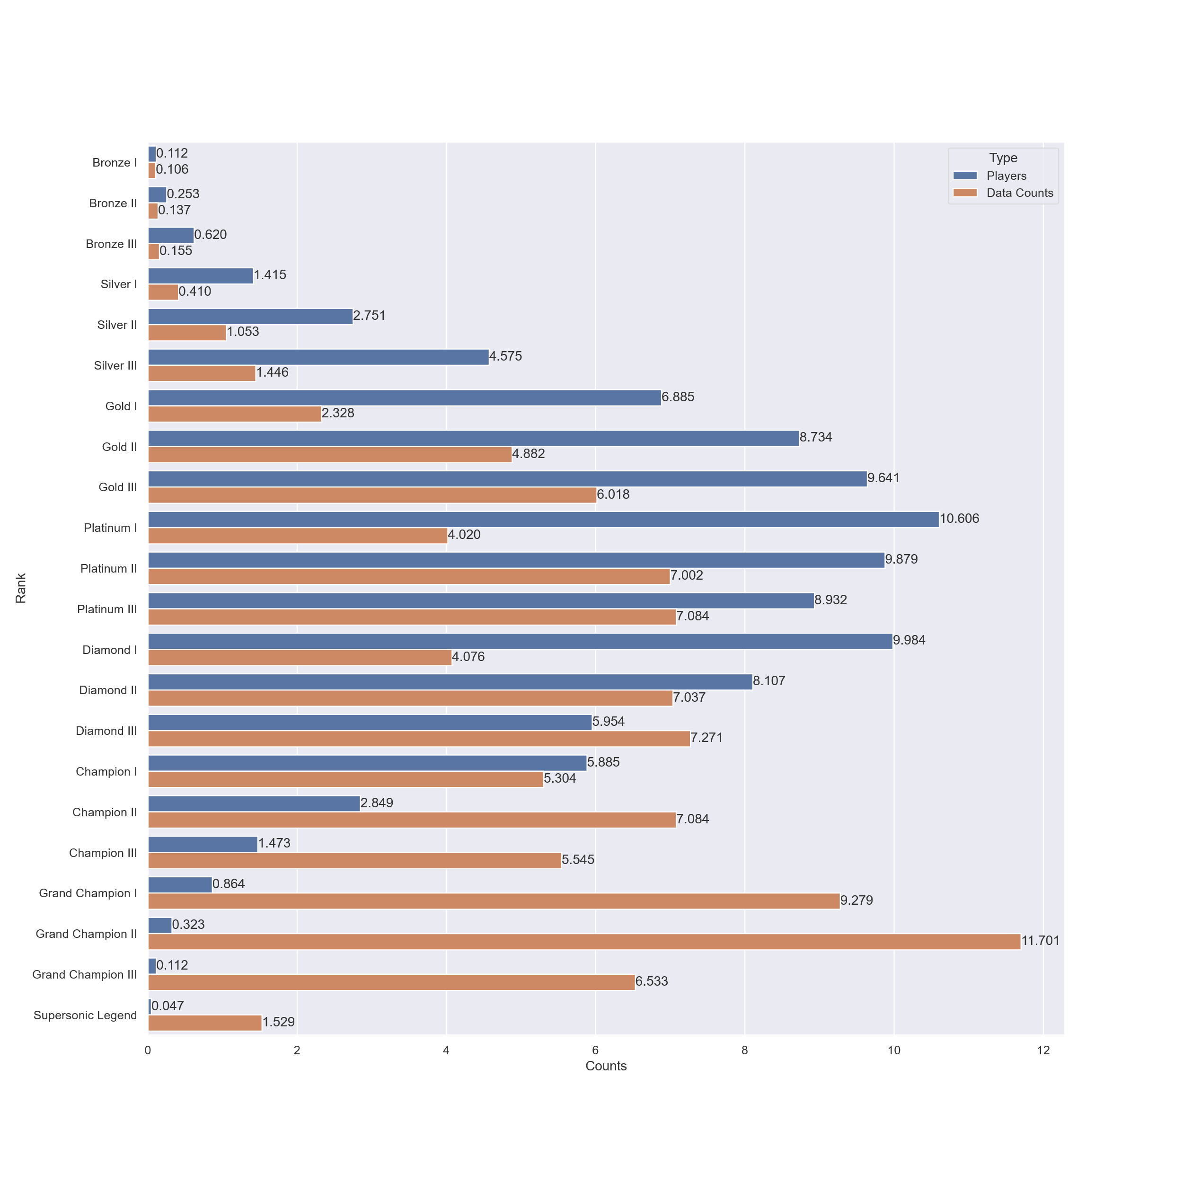
Data Understanding Data Exploration

Slide 20
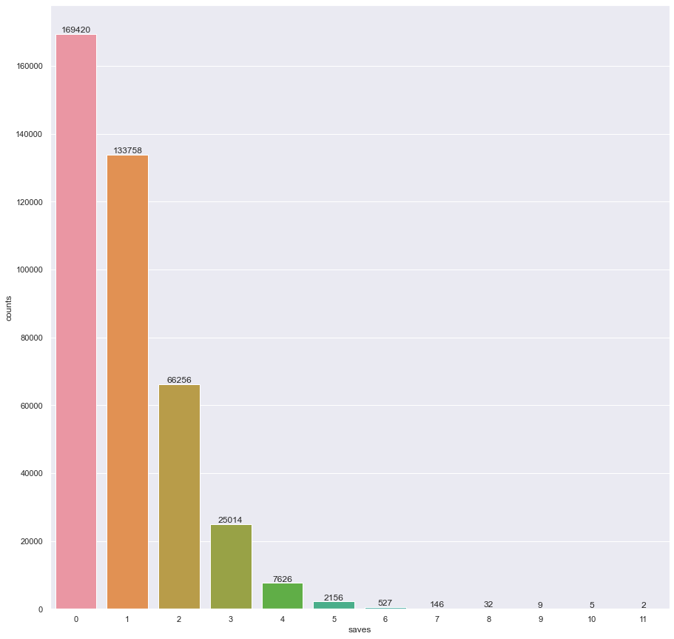
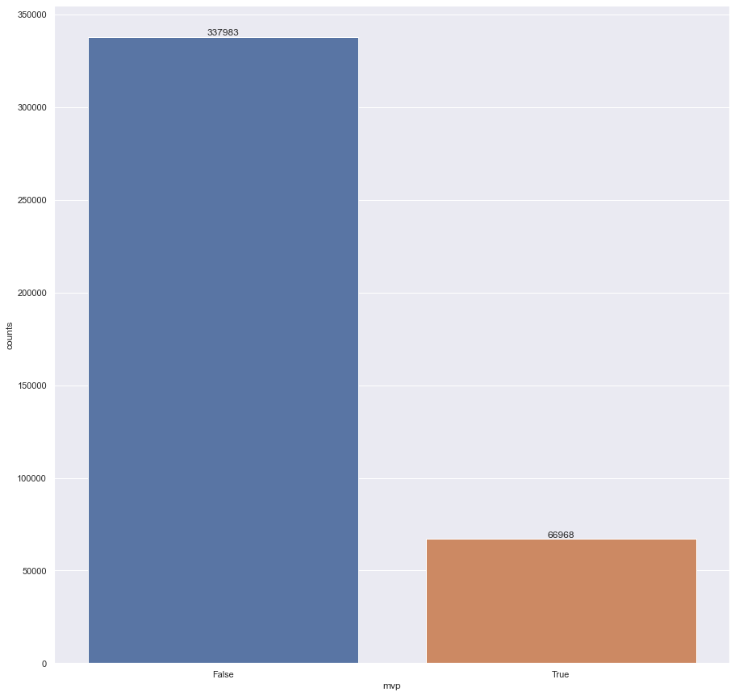
Data Understanding Data Exploration – Discrete / Categorial features

Slide 21
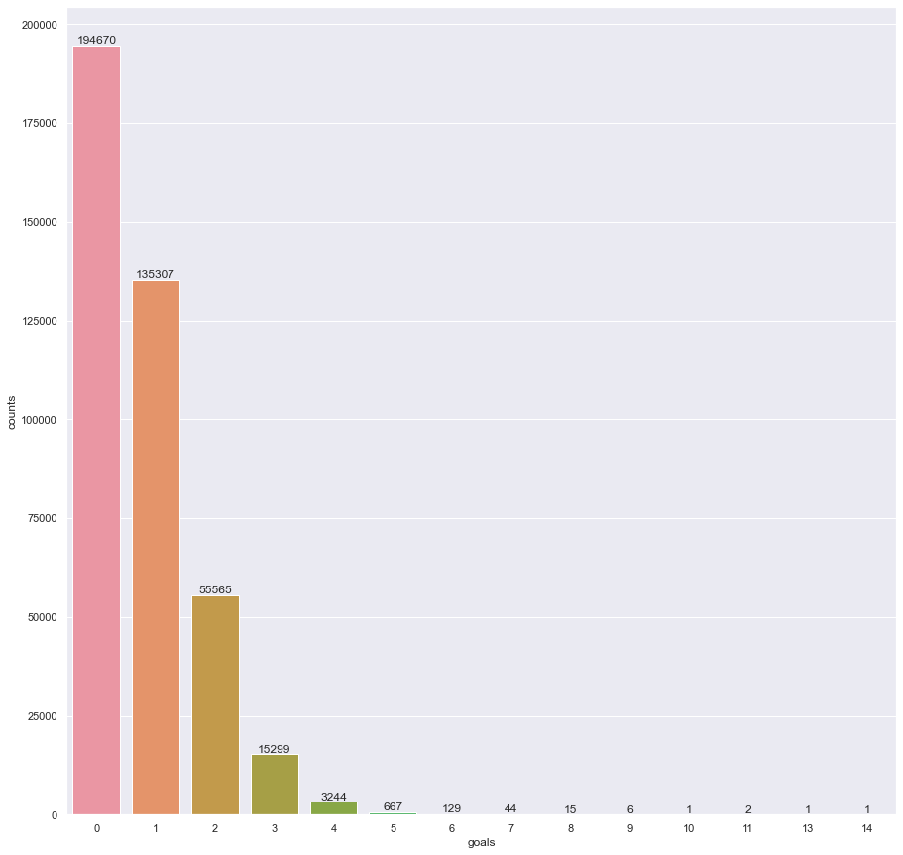
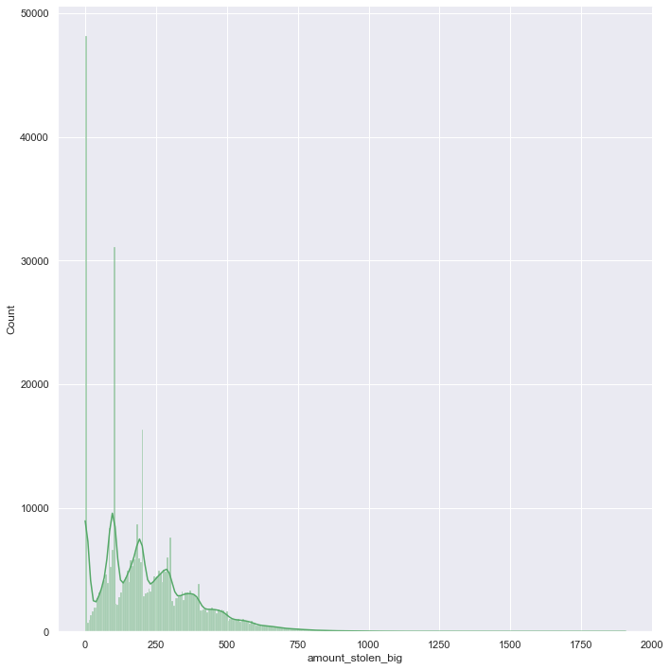
Data Understanding Data Exploration – Discrete features

Slide 22
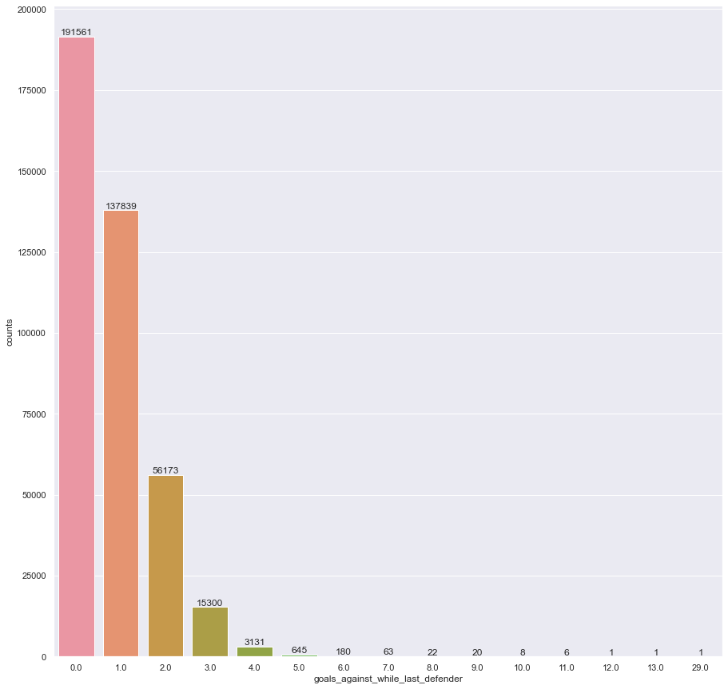
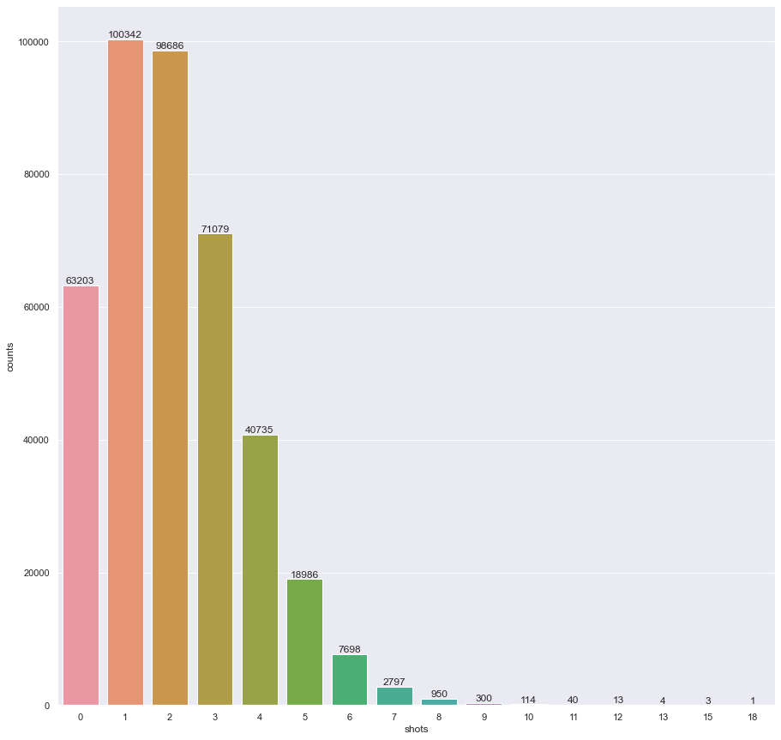
Data Understanding Data Exploration – Discrete features

Slide 23
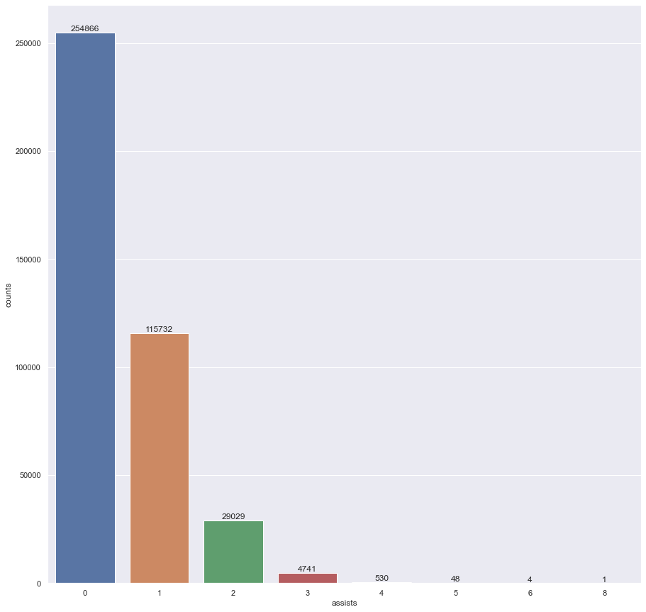
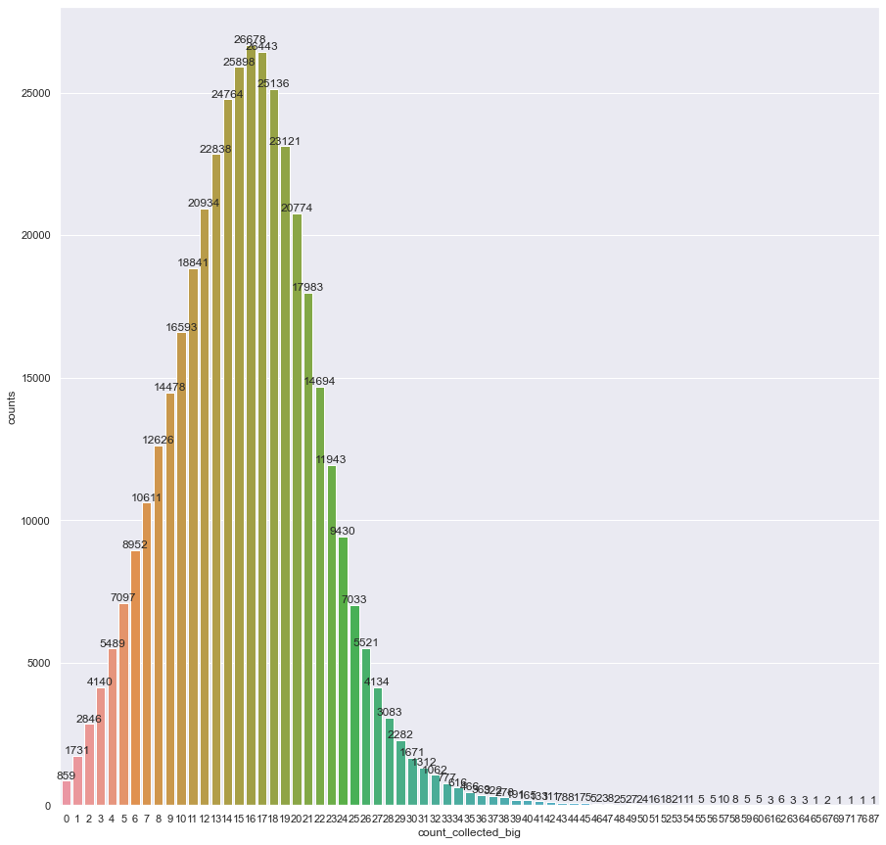
Data Understanding Data Exploration – Discrete features

Slide 24
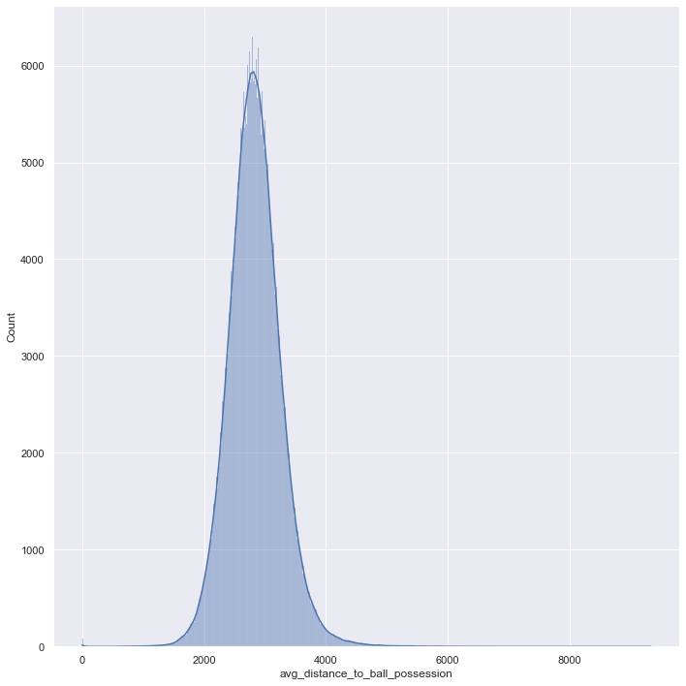
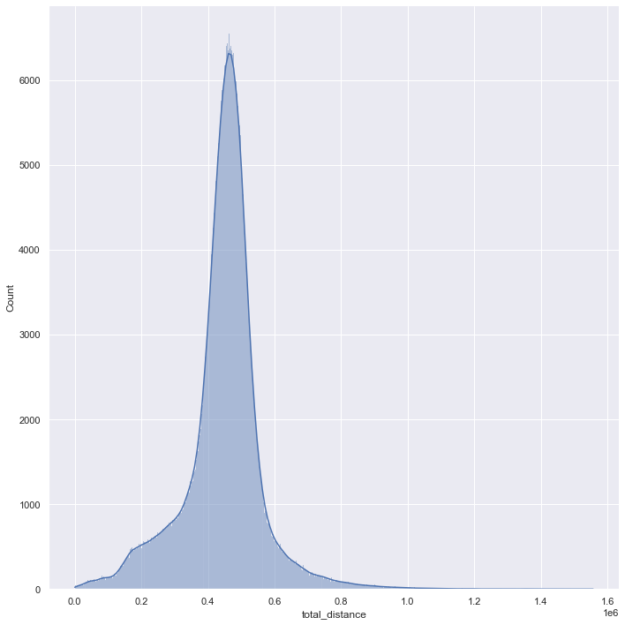
Data Understanding Data Exploration – Continuous features

Slide 25
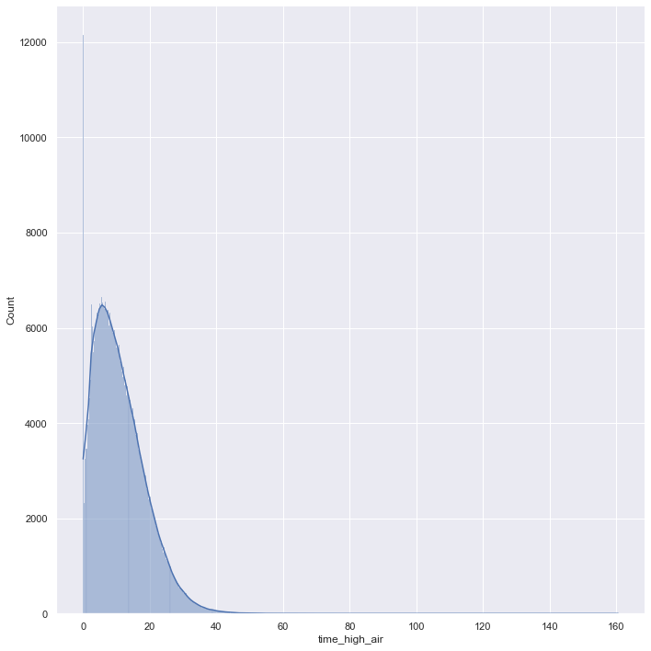
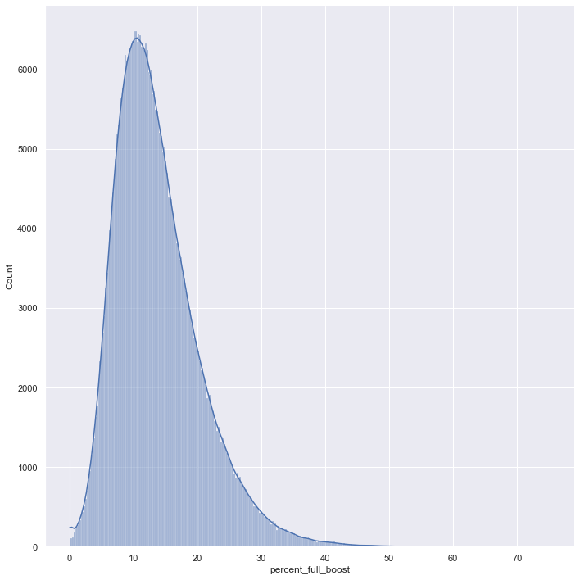
Data Understanding Data Exploration – Continuous features

Slide 26
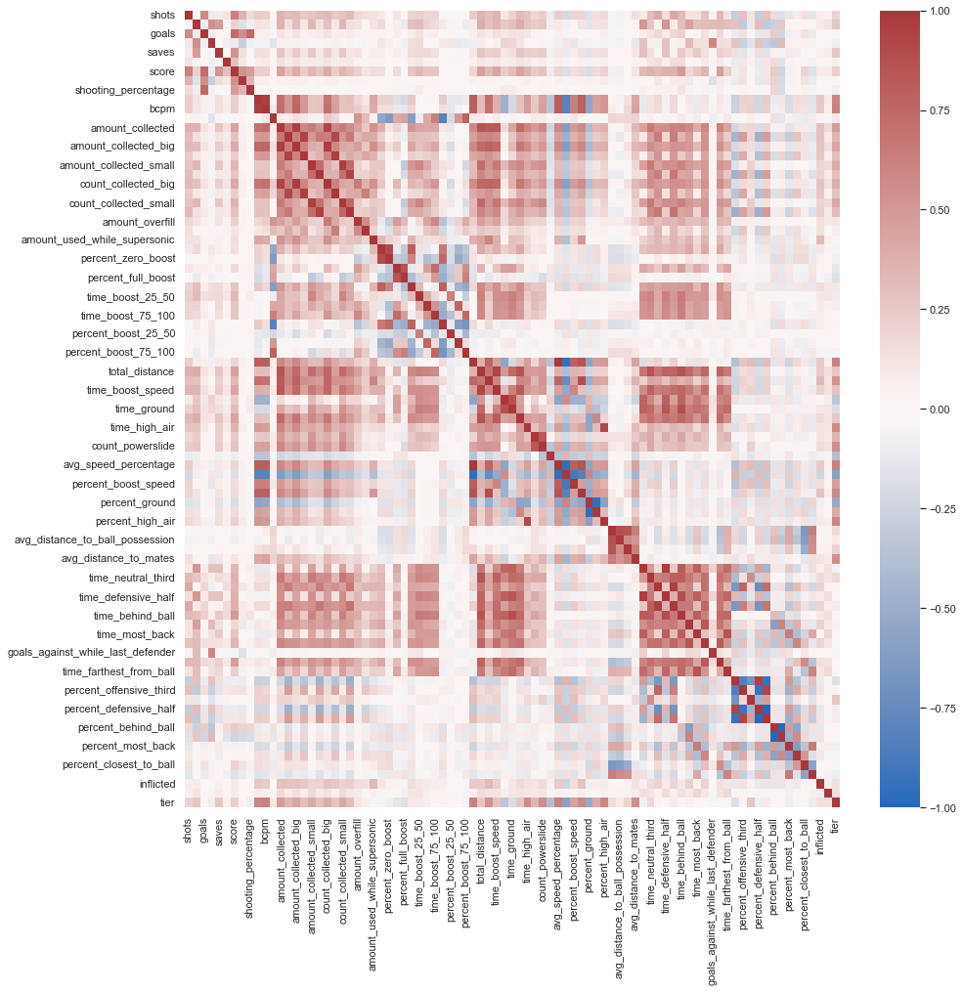
Data preparation Feature selection
A lot of correlated features
count/percentage
time/percentage
Boost collected / boost used
Etc.

Slide 27
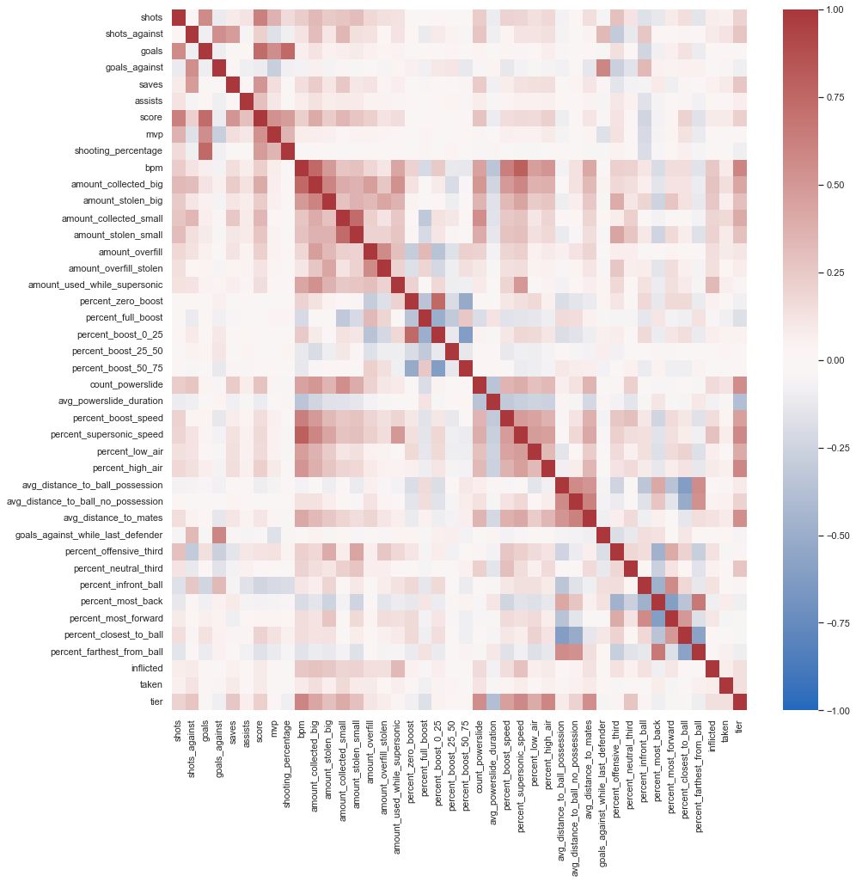
Data preparation Feature selection
From 84 features to 42

Slide 28
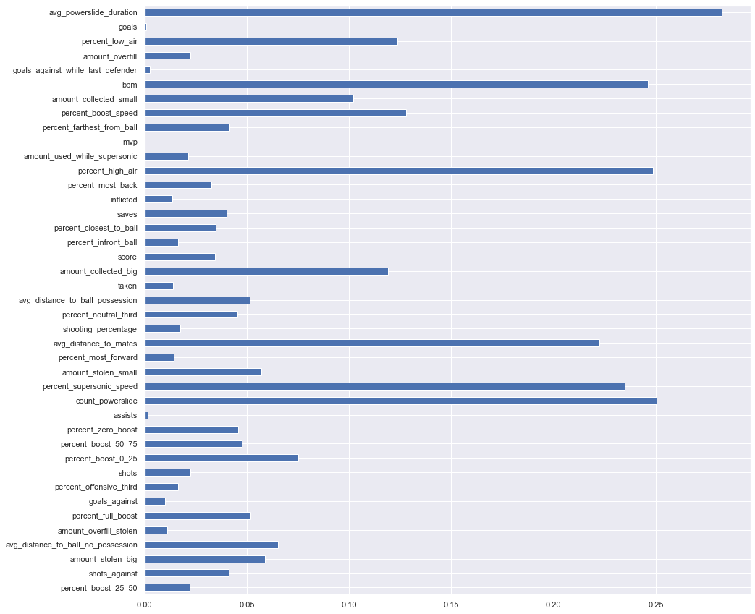
Data preparation Feature selection
Filter models
Information gain test

Slide 29
Data Preparation Feature selection
Insight give from the information gain test:
Remove match related features:
goals
mvp
assists
goals_against_while_last_defender
goals_against
Total 37 features

Slide 30
Data Preparation Construct data
Robust scaling, similar to z-score
but subtracts the median and
divides using the interquantile range between first and third quantile
Robust to outliers and more appropriated for skewed distributions
Percentages were simply divided by 100 (decimal scaling)

Slide 31
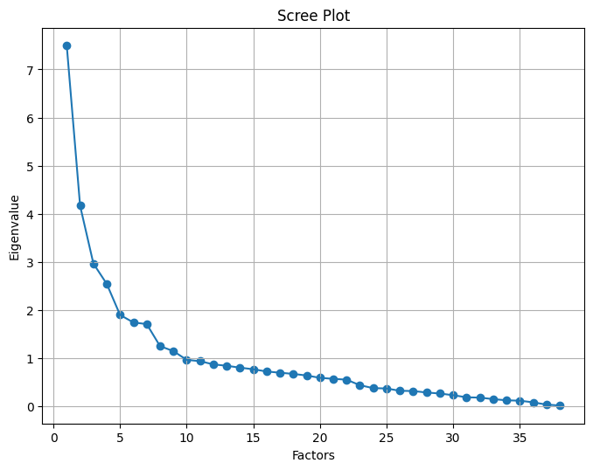
Data Preparation Factor analysis
Kaiser Criterion
9 eigenvalues above 1
10 factors chosen

Slide 32
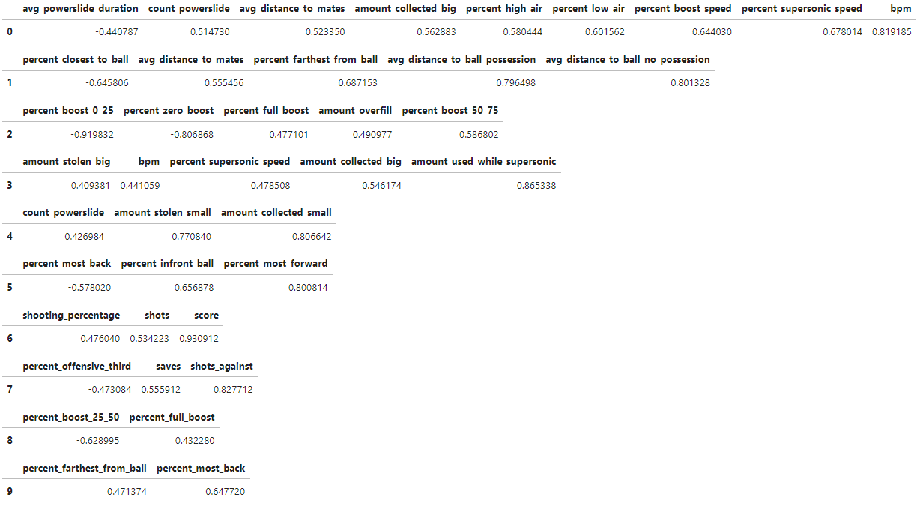
Factor loadings

Slide 33
Final datasets
Dataset preprocessed
Dataset factored
Stored as CSV files

Slide 34
Modeling
Propositional based methods chosen
Dummy regressor
Linear Regression
Gaussian Naive Bayes
k-Nearest Neighbors
Random forest
XGBoost
Multi Layer Perceptron

Slide 35
Modeling Metrics
Root Mean Squared Error
Mean absolute Error

Slide 36
Modeling Test design
Holdout:
2/3 for training
1/3 for testing
Hyperparameters selection:
10 fold Cross Validation

Slide 37
Modeling Build models
Hyperparameters
Dummy regressor
Strategy: median, mean
Linear regressor
None
Gaussian Naive Bayes
Class priors: None, class frequencies
k-Nearest Neighbors
K = 3, 5
Random forest
Criterion: Poisson, Squared Error
N° estimators: 10, 100
XGBoost
Importance: weight, cover
N° estimators: 10, 100
Multi Layer Perceptron
Alpha = 1e-3, 1e-4, 1e-5
LR = 1e-3, 1e-2

Slide 38
Modeling Compare models
Model | «Normal» MAE | «Normal» RMSE | «Factored» MAE | «Factored» RMSE
dummy | 3.9039 | 4.5511 | 3.9039 | 4.5511
knn | 2.1571 | 2.7837 | 2.1475 | 2.7641
linear | 1.8501 | 2.3843 | 2.114 | 2.6793
mlp | 1.571 | 2.0454 | 1.9234 | 2.474
naive bayes | 2.3666 | 3.3452 | 2.306 | 3.2595
random forest | 1.673 | 2.1785 | 1.9423 | 2.4984
xgb | 1.646 | 2.1277 | 1.9618 | 2.5185

Slide 39
Modeling Compare models
Model | «Normal» Fit time | «Normal» Score time | «Factored» Fit time | «Factored» Score time
dummy | 0.0082 | 0.0045 | 0.0082 | 0.0045
knn | 0.0676 | 296.0647 | 0.5632 | 7.3532
linear | 3.9348 | 0.0119 | 0.5239 | 0.0053
mlp | 256.14 | 0.2554 | 136.2348 | 0.1384
naive bayes | 1.2735 | 1.0172 | 0.363 | 0.2873
random forest | 155.852 | 0.3898 | 64.724 | 0.3123
xgb | 33.6242 | 0.0185 | 25.7821 | 0.0179

Slide 40
Modeling Assess model
Compare model with data mining criteria
MLP with Normal preprocessing:
MAE : 1.5710 < 2
RMSE : 2.0454 < 2.5
Score time on the whole test set (0.1384s)
Largely lower than 0.5 on six examples

Slide 41
Evaluation Evaluate results
Business Analyst required
System achieved good results
Players are more satisfied with a ranking system that take in accounts their performances during the match
Conceivable to suppose that business objectives and success criteria could be satisfied

Slide 42
Evaluation Review process
MLP and Neural Networks could be more explored
Extract features directly from raw replays
Difficult to improve the obtained error
Information to discriminate player ranks could not be contained in data

Slide 43
Deployment and Maintenance
System can be implemented directly in the game servers
New MMR calculated with a weighted sum from the predictive model and the old system
Play-style changes over months, model need to be retrained periodically (2-3 months)

Slide 44




Thanks for the attention
Pasquale De Marinis

